Slide 1


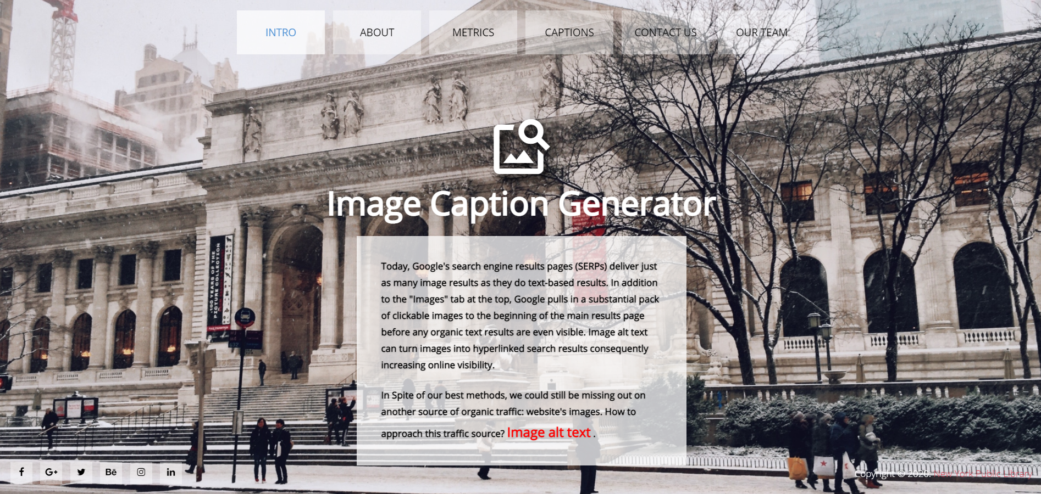
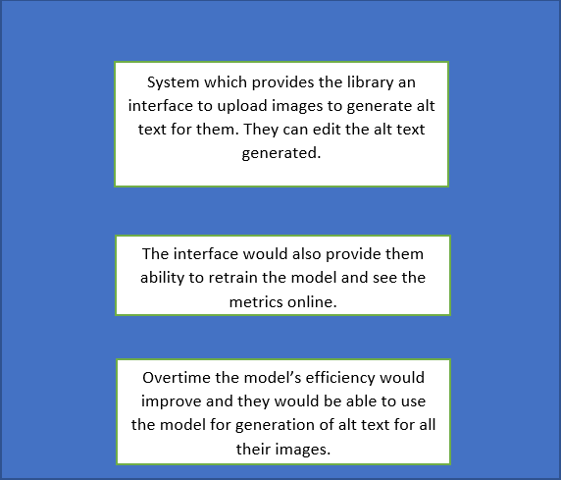
NYPL Improving Accessibility
Team: Abhijeet Sant, Nikita Amlani, Rohit Saraf, Shreya
Supervised by Prof. Jean-Claude Franchitti Project Manager: Sharon Denning
About the NYPL
The Interface
Business Value
.
The New York Public Library (NYPL) was established in 1895 in New York City. With nearly 53 million items and 92 locations, the NYPL is the second largest public library in the United States and the third largest in the world. It is a private, independently managed nonprofit corporation operating with both private and public financing.
The solution that we created improves the library operations in the following ways:
Helps the library automate the alt text generation which is necessary to help the users by increasing accessibility
With help of an interface they can validate the alt text getting generated by the model and edit it as needed.
Business Architecture
Business Objectives
This project was developed in collaboration with NYPL’s Digital Collection division. Its purpose is to facilitate automate alt text tagging of digital collection.Our solution focused on the FSA collection, which is composed of over 40 thousand images.
The solution is aimed to save valuable time which would be spent to add alt text to all the images that get added to the digital collection.
The end to end system would give the library the resource to edit the text generated and to keep retraining the model as they keep adding new images which would ensure continuous learning.
Business Solution Design
Our solution is designed to address the collection needs and perform the following basic tasks:
Provide an end to end system which can generate alt text using machine learning model
Auto generate alt text for recently uploaded images
Provide a solution which will keep retraining and improving over time and help the library save time .
Current and Future Use Cases
Our current site provides the NYPL with the facility to upload images and generate alt text using the model that we have trained and edit it as needed. It also has a feature to get all the recent images and generate the alt text for them. In future the predictions can be improved, and we can automate the alt text on search functionality.
Notes:
‹#›

